Slide 1
My thesis
Trần Quang Đạt
Notes:
Good morning prof Vo Van Toi, and the comitee
Thanks for your attending in the defend of my thesis
45s

Slide 2
Radiologist-Level CAD to detect 14 Thoracic diseases
Trần Quang Đạt

Slide 3
Table of contents
Purpose
Related Works
Methodology
Experiments & Results
Conclusion
Notes:
Here is what we will discuss today
The 1st is the purpose, why I do this topic
We then take glimpse at Relate works
before quickly move on to my methodology
We then take a look at my experiments and Results I obtains
And close the talk with conclusion and a demo

Slide 4
Purpose
Radiologist-Level CAD to detect 14 Thoracic diseases
Trần Quang Đạt
Notes:
1m15

Slide 5
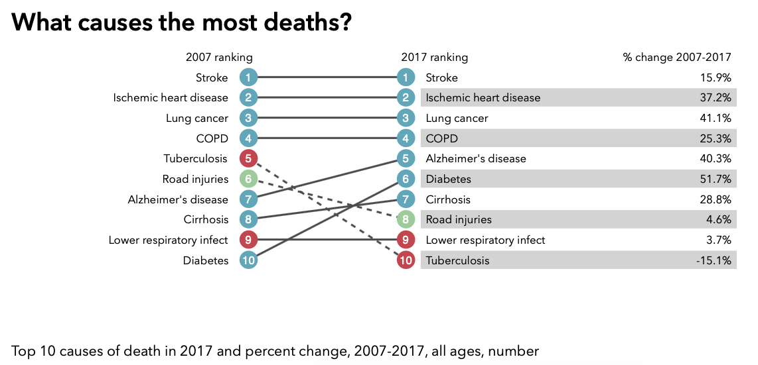
START WITH WHY
Lung diseases are the leading cause of death in developing countries
Chest X-ray (CXR) is the most common biomedical imaging & the most effective way to diagnosis many kind of lung diseases
Effective interpretation of CXR requires years of experience, time consuming
Top 10 causes of death in 2017 and percent change, 2007-2017, all ages, number In Vietnam. Credit
Notes:
....
For example, in 2017, 4 out of of the top 10 cause of death in vn were lung diseases
Currently, CXR
However, effective interpretation of CXR

Slide 6
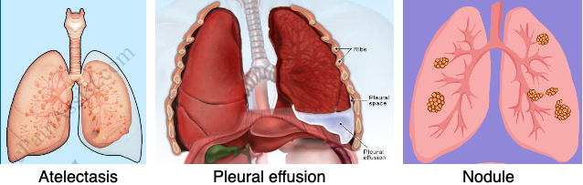
What Can I do
In 2017, US NIH released CXR-14 dataset with over 100K images
14 different diseases: Atelectasis, Cardiomegaly, Pleural Effusion, Infiltration, Mass, Nodule, Pneumonia, Pneumothorax, Consolidation, Edema, Emphysema, Fibrosis, Pleural Thickening, and Hernia
An opportunity to develop a CAD that can heftily assist radiologists.
Notes:
I started to think about helping to solve this problem and
I found that in 2017, National Institude of Health
I see this as an opportune… a system …
-------------------------------------------------------------------------------------------------------------------------
Atelectasis: A complete or partial COLLAPSE of the lung, the disease can be seen in CXR at which the lung is missing completely or partially.
Cardiomegaly : Enlargement of the heart.
Pleural Effusion: An unusual amount of FLUID around the lung, the disease causes the lung to lung to appear white in CXR.
Infiltration : Abnormal SUBSTANCES accumulate gradually that occurs within or spreads as through the interstices of the lung.
Mass: Abnormal matter 3 cm+
Nodule: 3 cm-
Pneumonia: Inflammatory condition of the lung cause by bacterial, fungi, etc
Pneumothorax: Abnormal collection of AIR in the in the pleural space.
Consolidation: hardening of lung tissue
Edema: Fluid accumulation in the tissue and air space of the lung
Emphysema: the breathing tubes are narrowed, and the air sacs are damaged, which causes shortness of breath.
Pulmonary fibrosis: Excess of fibrotic tissue in the lung, lead to scars are formed in the lung tissues.
Pleural Thickening: Extensive scarring thickens the lining of the pleural.
Hernia: Protrusion of lung outside of the thoracic wall.
------------------------------------------------------------------------------------------------------------------------

Slide 7
Related works
Radiologist-Level CAD to detect 14 Thoracic diseases
Trần Quang Đạt
Notes:
I started to look into the wild
1m30

Slide 8
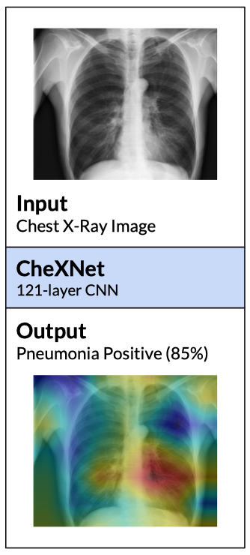
Rajpurkar et al., 2017
Use 1-stage model
DenseNet Extractor+ Binary Classifier
Contribution: Compare to 4 radiologists in detecting pneumonia
Cons: Simple approach
Notes:
The 1st method I encountered …
Compare the performance

Slide 9
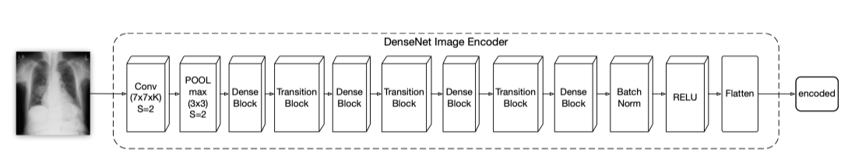
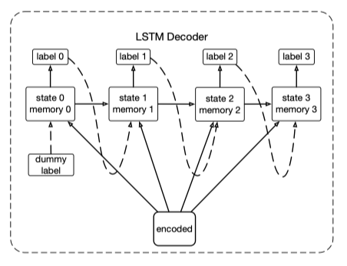
Yao et al., 2017
Use 2-stage model
DenseNet Encoder + LSTM Decoder + Binary Classifier
Contribution: Model labels dependencies using LSTM
Cons: Not appealing performance
Notes:
Also around that time, …
However, their method did not yeild

Slide 10
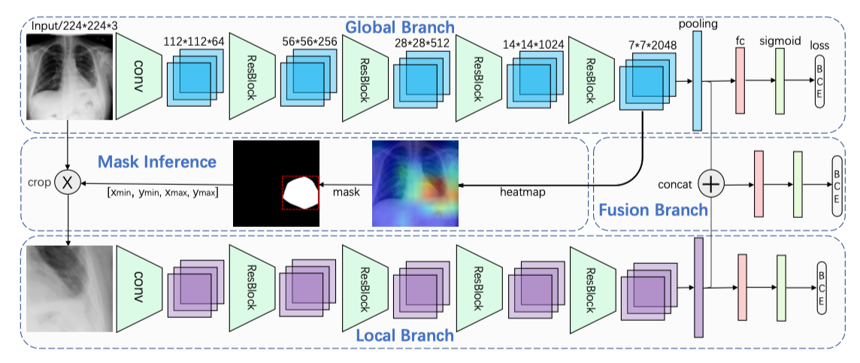
Guan et al., 2018
Use 3-stage model
Global + Local + Fusion + Binary Classifier
Contribution: implicit attention mechanism by activation heatmap
Cons: Unknow applicable to other tasks.
Notes:
Toward 2018, …
Global branch look at the whole image than produce an activation heatmap
From the heatmap, they cut only the ROI and run through the local branch to extract features
Then they fuse the of local and global features for final prediction
Their main contribution is implicit… However it is unknown if their approach is applicable to other biomedical tasks.

Slide 11
Methodology
Radiologist-Level CAD to detect 14 Thoracic diseases
Trần Quang Đạt
Notes:
Inspiration from Guan result ..
5min

Slide 12
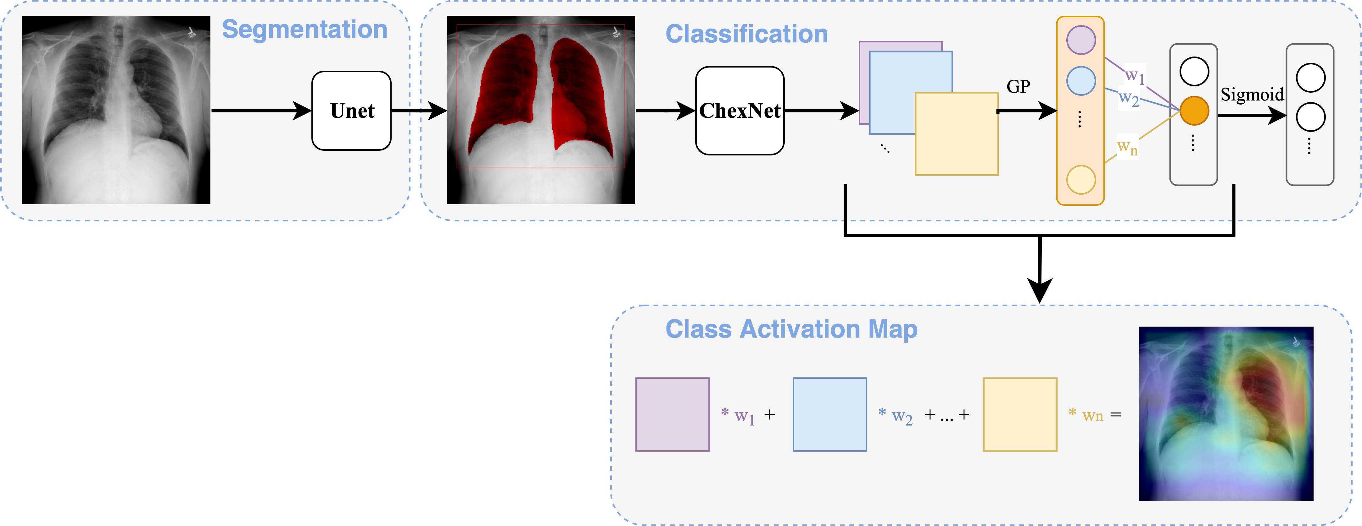
My Proposed method
Use 2-stage model
Lung segmentation + DenseNet Extractor + Binary Classifier
Contribution: explicit attention guided segmentation
CAM for visualization
Notes:
I used a 2 stage model
The 1st stage I perform lung segmentation to cut out the lung region as the input forthe feature extractor in the 2nd stage
My main contribution is provide an explicit attention mechanism using lung segmentation
I also use Class Ac… Map to visualize the result

Slide 13
Dataset
ChestX-ray 14 (classification):
112,120 CXRs from 30,805 patients
70% train, 10% validate, 20% test; no patient overlap
JSRT (Japanese Society of Radiological Technology):
247 CXRs with corresponding masks
70% train, 10% validate, 20% test
MC (Montgometry County):
138 CXRs with corresponding masks
70% train, 10% validate, 20% test
Combine JSRT and MC for segmentation
Notes:
The main dataset is
CXRs from ... patients
Divide to 70%, … for training, validate, and testing respectively
For lung segmentation, we use nearly 400 images combine from 2 dataset …
I also divide training, val, test into 70, 10 and 20%

Slide 14
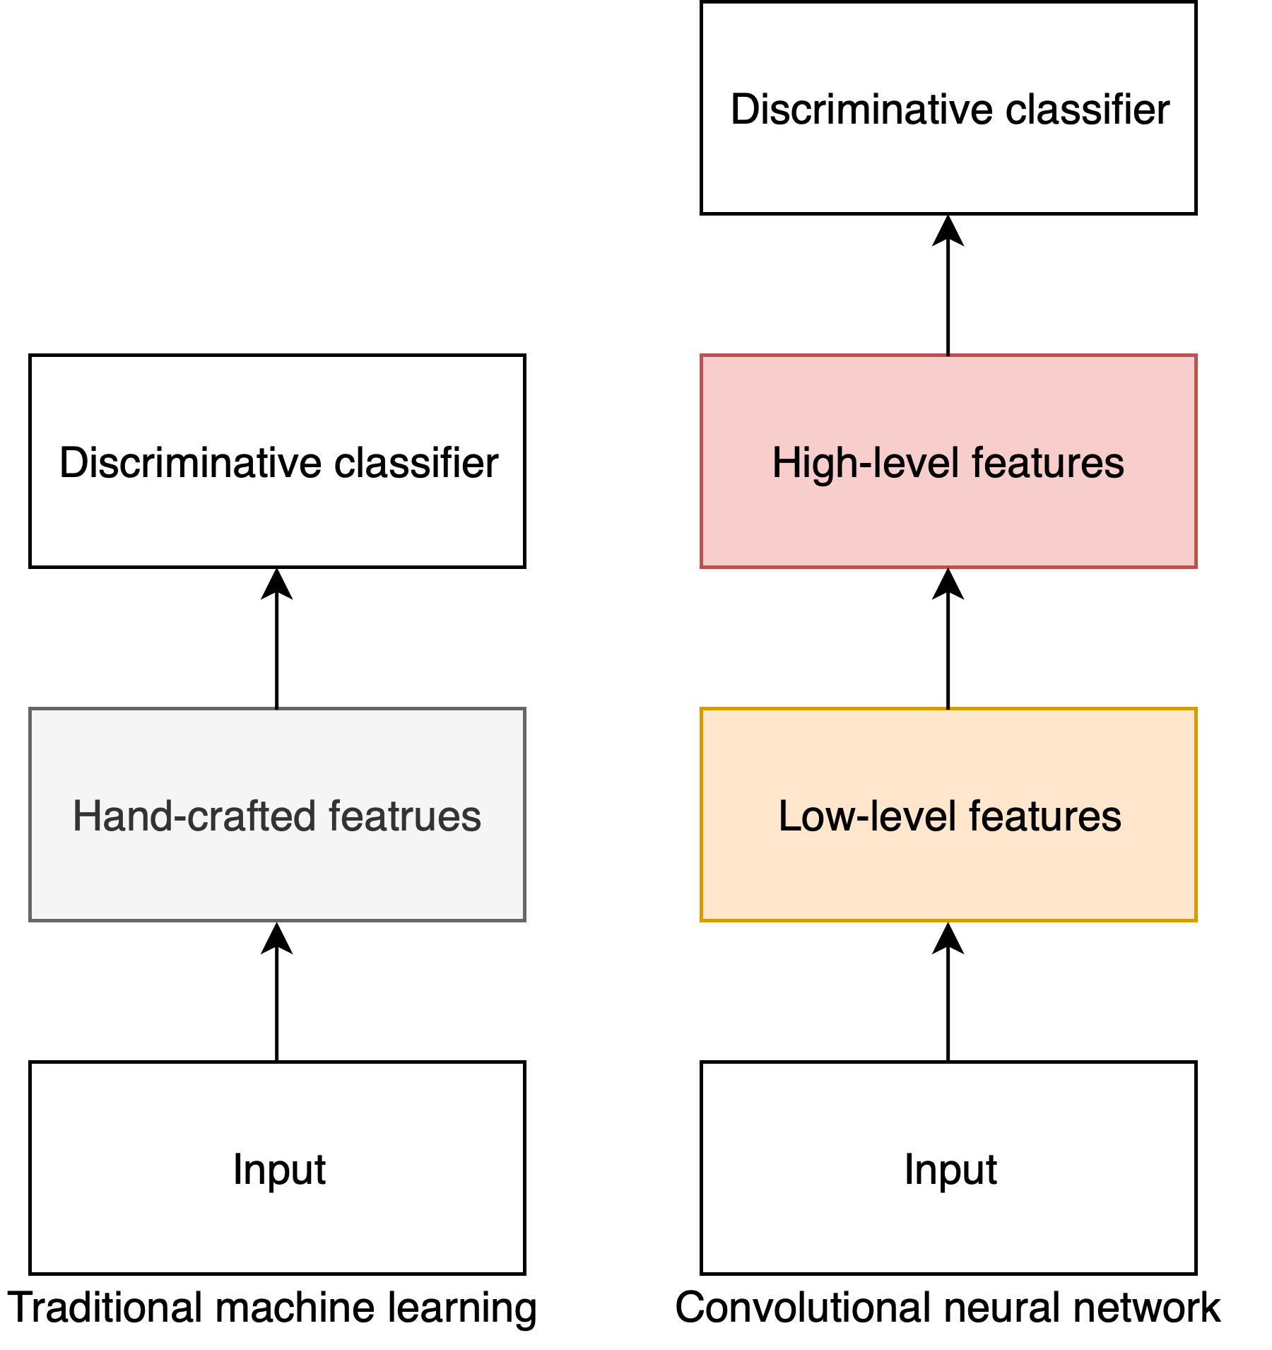

Convolutional neural network (CNN)
Use convolutional filter to extract features
Filter weights are learnt by optimizing an objective function (loss function)
Stack layer of convolutional filters
Learn representation from low-level to high-level
Visualize 2D convolution. Credit
Notes:
Before looking at the model, let explicitly introduce the Convo … also know as CNN
In traditional machine, researchers use hand crafted features that requires domain knowledge to design.
However, CNN use convolutional filter to extract the feature and the feature weights
CNN also stack layer to learn to representation form ….

Slide 15
Thoracic classification
ResNet
DenseNet
Notes:
I applied CNN thoracic clas
Explicitly, i use Resnet and DenseNet

Slide 16
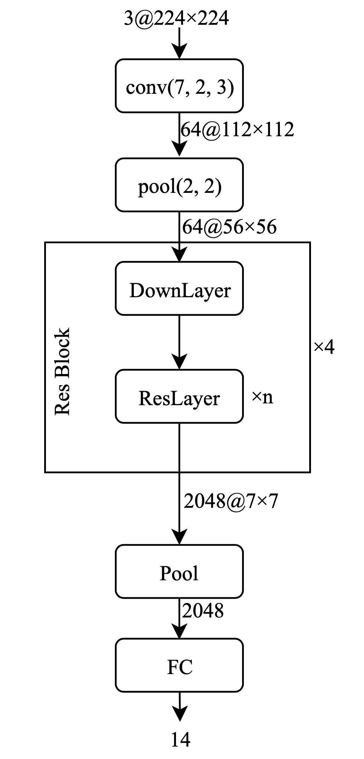
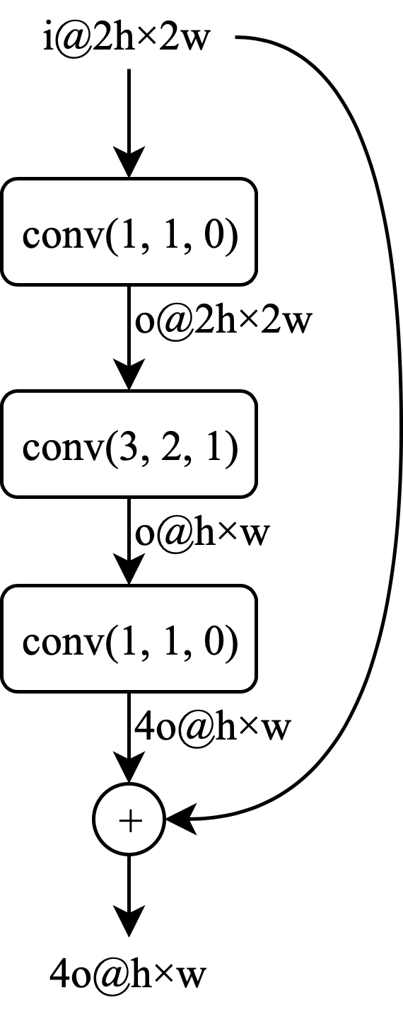
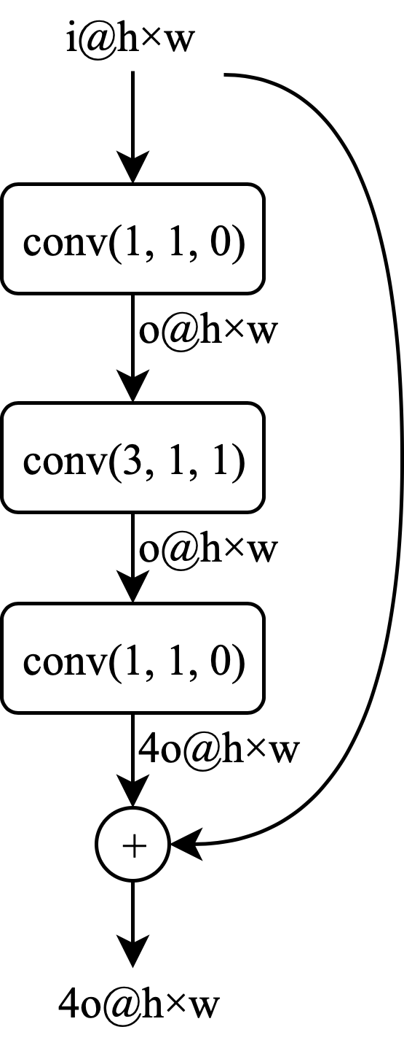




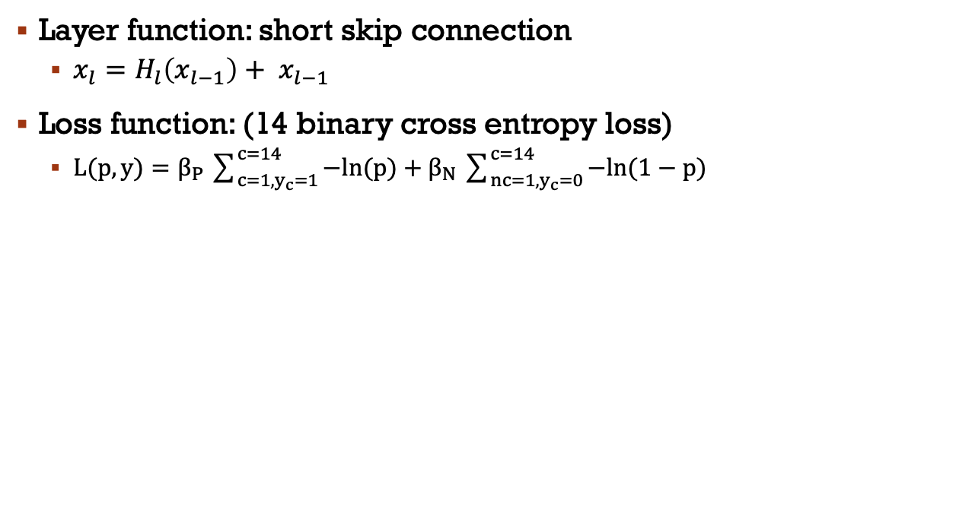
ResNet (He et al., 2015)
Layer function: short skip connection
$x_{l}=H_{l}\left(x_{l−1}\right)+ x_{l−1}$
Loss function: (14 binary cross entropy loss)
$L(p, y)=β_{P}\sum_{{c=1, y}_{c}=1}^{c=14}{−ln(p)}+β_{N}\sum_{n{c=1, y}_{c}=0}^{c=14}{−ln(1−p)}$
ResNet, simplified
Down Layer
Residual Layer
Notes:
Here is the high level view of Resnet
Input image and produce probabilities for each disease
The model have convolution layer, max pool layer -- with is the special convolution layer and a residual block
The resblock consists of the down and residual layer
The down layer and residual are just different in spatial dimension of the output
They both use the shortcut connection to help boosting the learning progress
The loss function is the total of summation of the bc loss for 14 disease

Slide 17
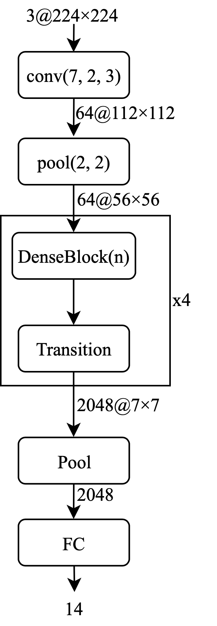
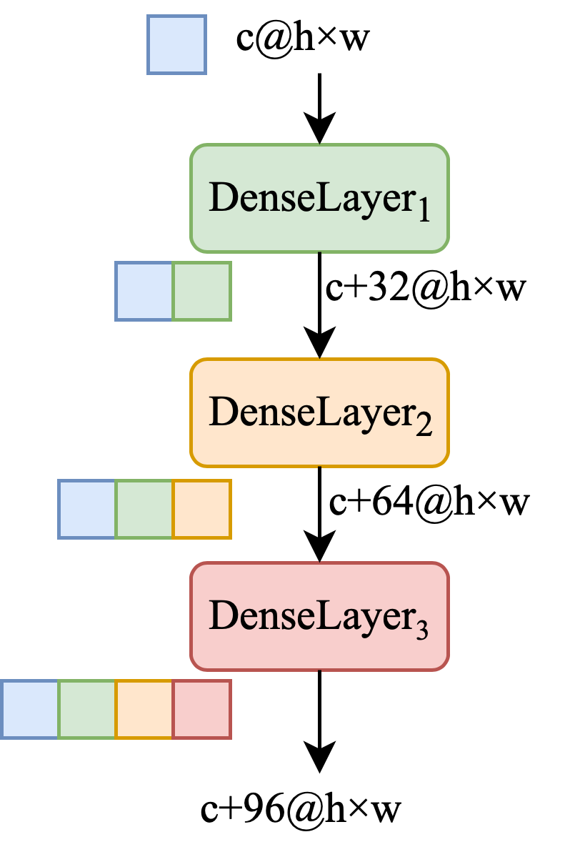
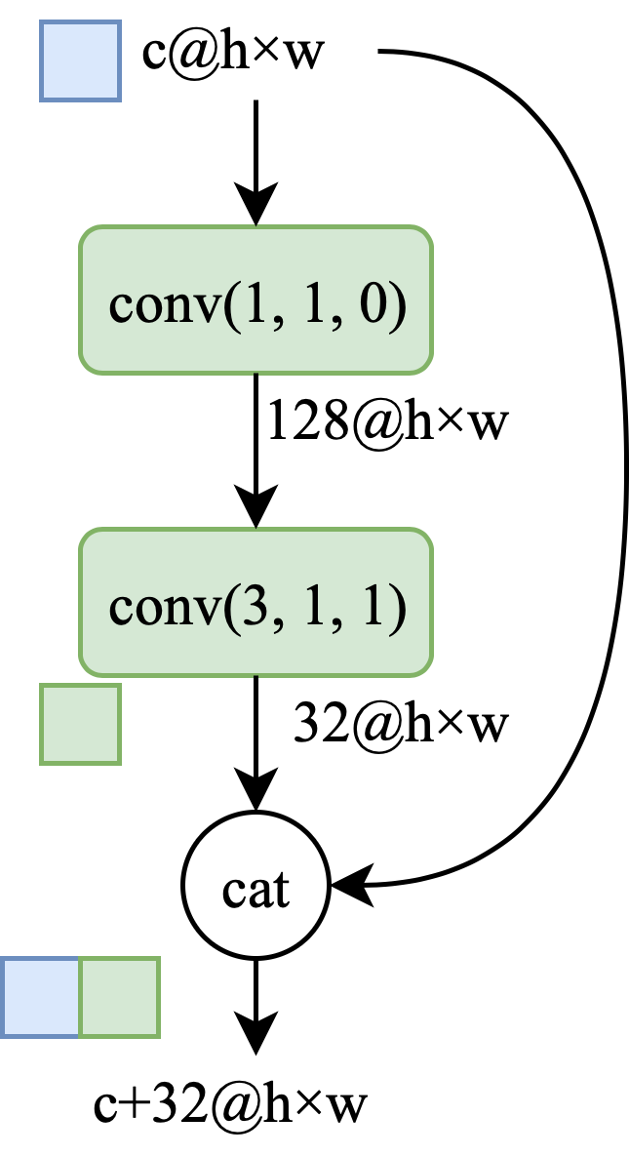
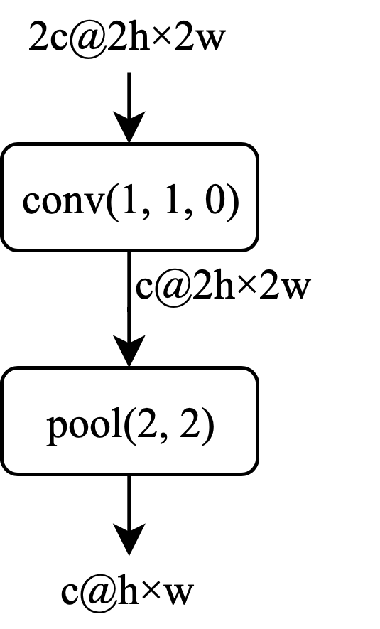


DenseNet (Huang et al., 2016)
Layer function: short skip connection
$x_{l}=H_{l}\left({[x}_{l−1},x_{l−2}, …,x_{0}]\right)$
DenseNet, simplified
Dense Layer
Dense Block
Transition Block
Notes:
Another model I experiment with is the DenseNet
Here is the high level overview of the DenseNet, take an input image and output probabilities of each diseases
The model is similar to Resnet, but here we have DenseBlock and Transition Block
The DenseBlock is learnt by cascade the input to every DenseLayer in the Block
The model do it by also using a short skip connection, but instead addition like resnet, they concatenate the input with the feature mapping output
The transition block reduce the spatial dimension of the input

Slide 18
Lung segmentation
Unet
Notes:
The other part of my method is lung segmentation, we use Unet model to do the task

Slide 19
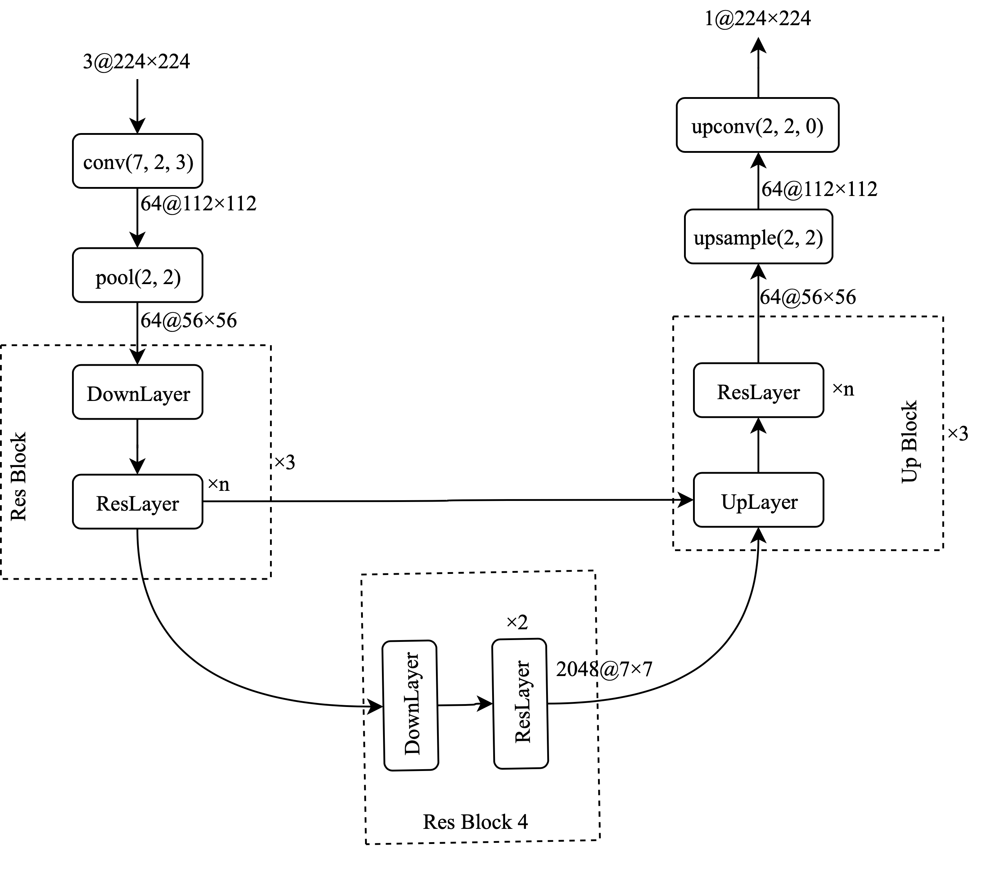
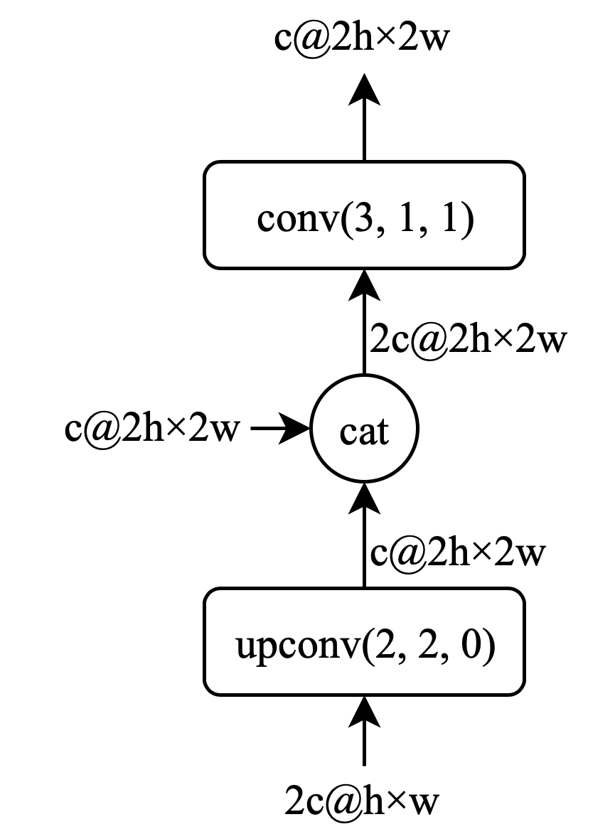


Unet (Ronneberger et al., 2015)
Modified ResNet + Long skip connections
Loss function: (pixel-wise binary cross entropy loss)
$L(p, y)=\sum_{i=0, j=0}^{i∈H,j∈W}{−y_{i, j}ln(p)}+\sum_{i=0, j=0}^{i∈H,j∈W}{(1−y_{i, j})ln(1−p)}$
Up Layer
Unet, simplified
Notes:
Here is the high level overview of the unet, combine with the encoder, with is resnet and decoder part
The encoder will learn the latent representation of the input image
The decoder will reconstruct the spatital information from the latent vector with the help of the long skip connection in the UpLayer and output the mask of the lung region
The UpLayer will take the high(er) level representation and concat the feature map from the skip connection to learn the reconstruction of the lower representation
The loss function is ..

Slide 20
Experiments & Results
Radiologist-Level CAD to detect 14 Thoracic diseases
Trần Quang Đạt
Notes:
Let’s talk about …
8 min

Slide 21
Hyper-parameter finding
Learning rate (lr)
Batch size
Epoch
-> To optimize the learning process
Notes:
First we experiment with the hyper parameter

Slide 22
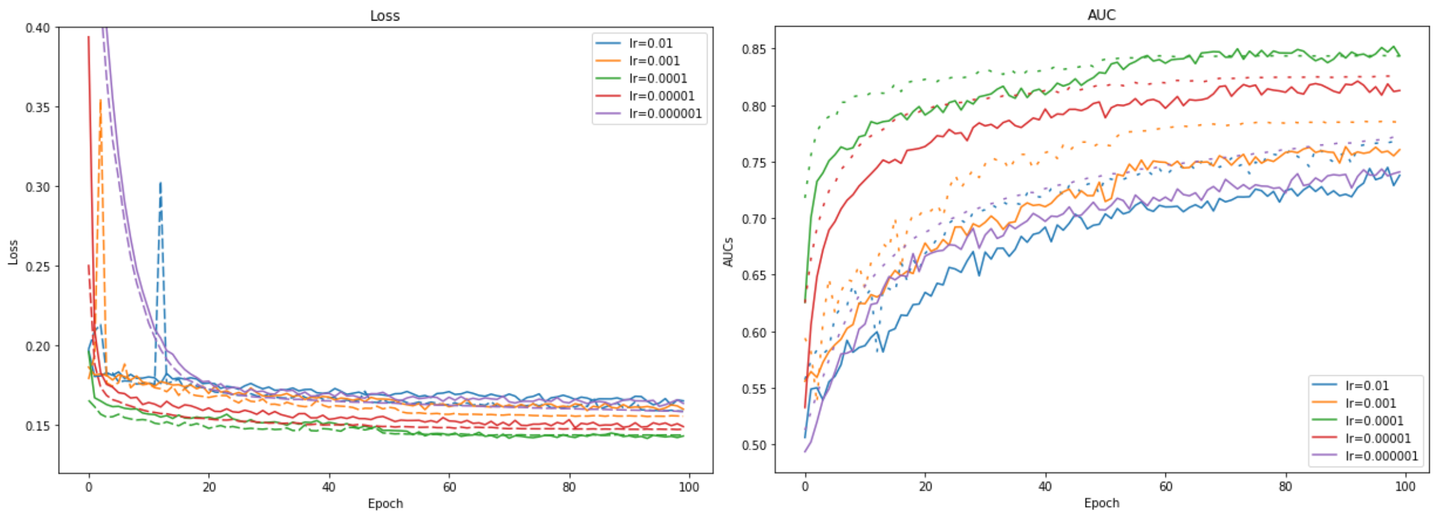
Learning Rate Finder
Step size for each training step
Optimal step size allow faster training
Just right lr=1e-4
Lower is better
Too small
Too big
Higher is better
Left: Loss for different learning rates, Right: AUC for different learning rates. Different experiments were color-coded, the solid line shows the training result, the dashed line shows the validation result. lr (Learning rate)
Notes:
1st the learning rate
….
The left one is the loss over the epoch, lower loss is better
The right one is the evalution metrics over the epoch, higher is better
Experiment is color coded, the solid line is training and dash line is validate
I experiment with lr =1e-6 to 1e-2
If the lr is too small, the learning progress will take a long time
If the lr is too big, the learning cannot converge to a optimal value

Slide 23
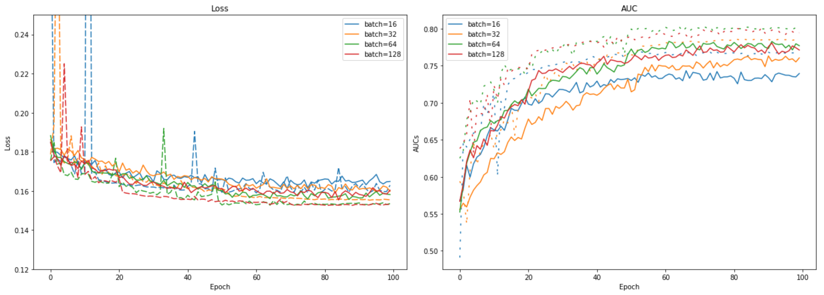
Batch Size Finder
#images for each training step
#images that represent the dataset for each training step
64 is better than 128
in the long run
64 and 128: a tie game
Left: Loss for different batch sizes, Right: AUC for different batch sizes. Different experiments were color-coded, the solid line shows the training result, the dashed line shows the validation result.
Notes:
I next experiment with the batchsize, which is the #images for ..
It mean the #images that represent
I next experiment with the batchsize from 16 to 128
I found that 64 and 128 is very good but 64 is better …

Slide 24
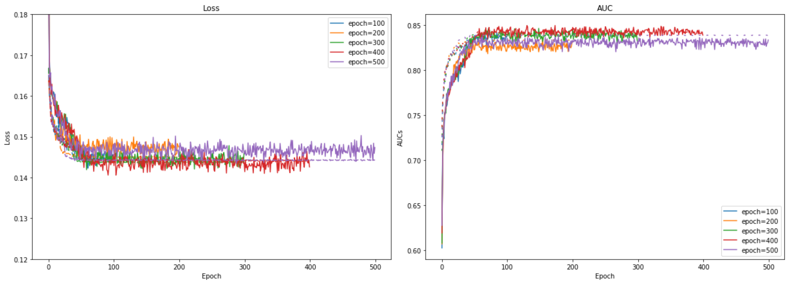
Epoch Finder
#iteration over the ENTIRE training set
How many iteration is enough?
Plateau at 100
Left: Loss for different epochs, Right: AUC for different epochs. Different experiments were color-coded, the solid line shows the training result, the dashed line shows the validation result.
Notes:
I next experiment with the epoch, which is … to find out how
By runing the experiment with epoch from 100 to 500
I found that the learning progress plateau at 100

Slide 25
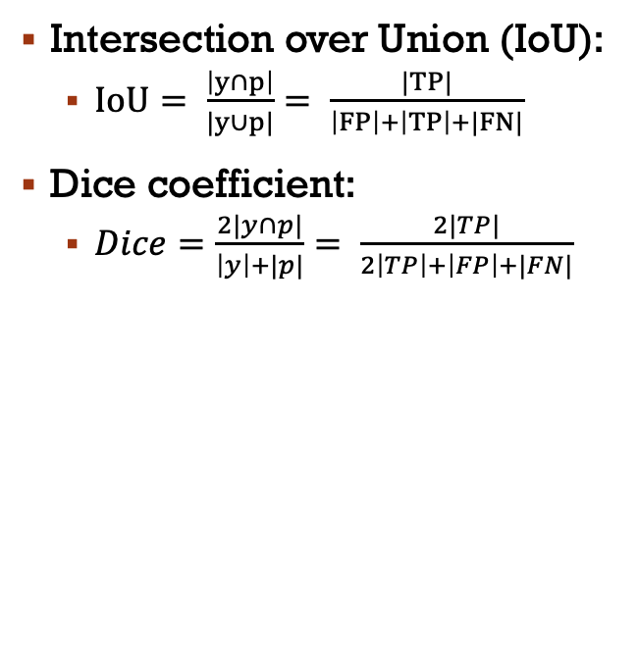
Result in Lung Segmentation
Intersection over Union (IoU):
$IoU= \frac{\left|y∩p\right|}{|y∪p|}= \frac{|TP|}{\left|FP\right|+\left|TP\right|+|FN|}$
Dice coefficient:
$Dice=\frac{2|y∩p|}{\left|y\right|+|p|}= \frac{2|TP|}{2\left|TP\right|+\left|FP\right|+|FN|}$
Dataset | Dice | IoU
JSRT | 0.969 | 0.919
MC | 0.971 | 0.930
Result on JSRT and MC
Notes:
Here is the result in lung segmentation
I use 2 metrics …
The table show the result in 2 lung segmentation dataset

Slide 26
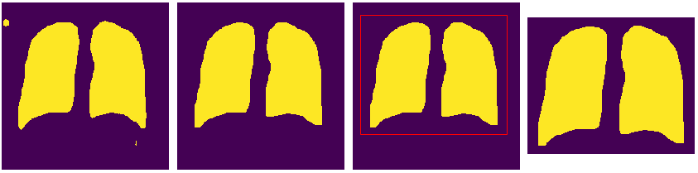
Preprocess lung segmentation
Morphological opening: erosion follows by dilation , kernel size = 10
Erosion: 1 if ALL is 1
Dilation: 1 if ANY is 1
Largest Connected Components
Crop lung region
Preprocess step-by-step to remove unwanted objects
Notes:
however, when apply to the CXR-14 dataset, there are unwanted objects, so i do following preprocessing step for cutting out the lung region
First I apply the morpho

Slide 27
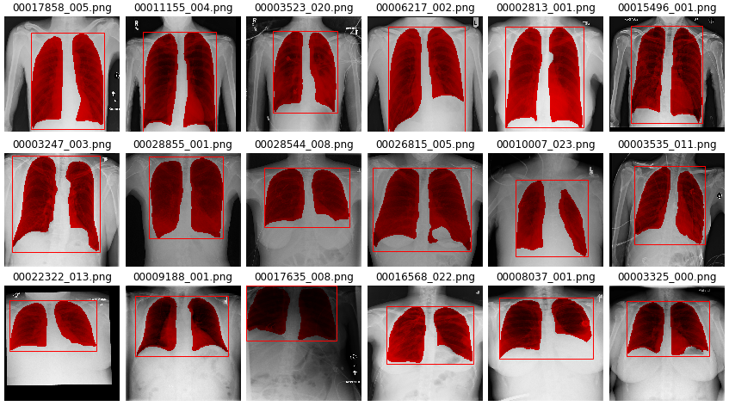
Result in Lung Segmentation
Lung segmentation on ChestX-ray 14 on different lung size

Slide 28
Thoracic Classification
ROC Curve: (1-specificity) as the x-axis and sensitivity as the y-axis as the decision threshold varies from 0 to 1.
AUC (Area Under ROC Curve): quantify expertise of the model
Notes:
Skip, explain ...

Slide 29
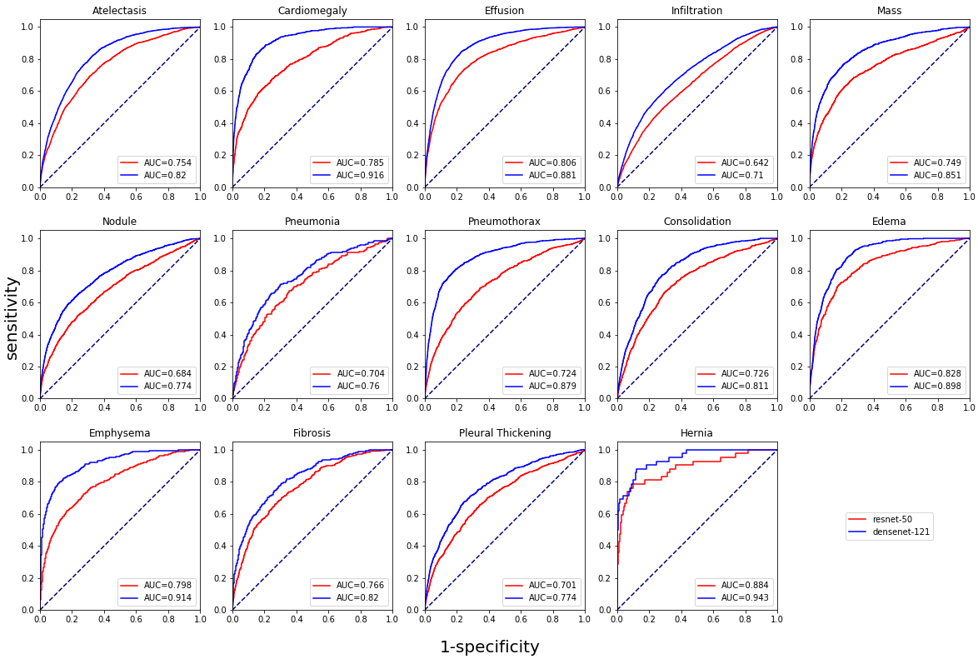
Result in Thoracic classification
ROC (Receiver Operating Characteristic) Curve and AUC (Area Under ROC Curve) on 2 classification mode: ResNet vs DenseNet for different diseases
Notes:
I evaluate the thoracic classification using
ROC Curve: (1-specificity) as the x-axis and sensitivity as the y-axis as the decision threshold varies from 0 to 1. The better model will have the ROC Curve to the top-left
AUC (Area Under ROC Curve): quantify expertise of the model
Here is the comparision between resnet and densenet model
I found that the DenseNet outperform Resnet on every disease

Slide 30
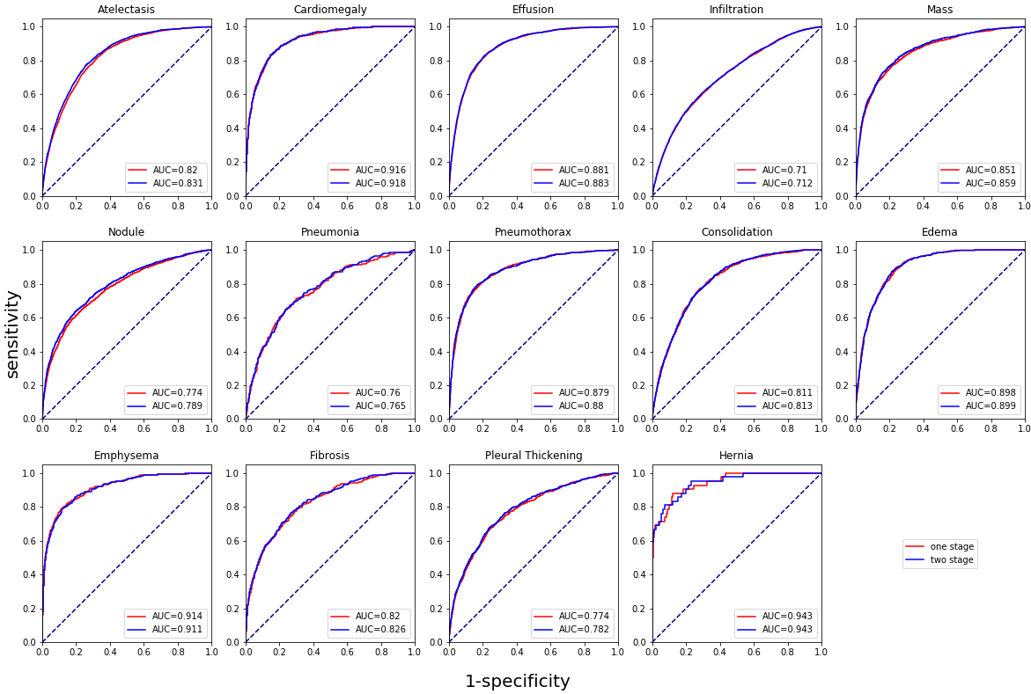
Result in Thoracic classification
1-stage (DenseNet) vs 2-stage (Segmentation + DenseNet) for each disease
Notes:
Here is the resilt in comparision between 1-stage and 2-stage model
The 1-stage mean
The 2-stage mean

Slide 31
Compare to Related works
3-stage model Guan et al.: SOTA
Lung segmentation did improve the performance
Method | Atel | Card | Effu | Infi | Mass | Nodu | Pne1 | Pne2 | Cons | Edem | Emp | Fibr | PT | Hern | Mean
Yao et la. | 0.772 | 0.904 | 0.859 | 0.695 | 0.792 | 0.717 | 0.713 | 0.841 | 0.788 | 0.882 | 0.829 | 0.767 | 0.765 | 0.914 | 0.803
Rajpurkar et la. | 0.809 | 0.925 | 0.864 | 0.735 | 0.867 | 0.780 | 0.768 | 0.889 | 0.790 | 0.888 | 0.937 | 0.805 | 0.806 | 0.916 | 0.841
Guan et la. | 0.853 | 0.939 | 0.903 | 0.754 | 0.902 | 0.828 | 0.774 | 0.921 | 0.842 | 0.924 | 0.932 | 0.864 | 0.837 | 0.921 | 0.871
Resnet-50 | 0.754 | 0.785 | 0.806 | 0.642 | 0.749 | 0.684 | 0.704 | 0.724 | 0.726 | 0.828 | 0.789 | 0.766 | 0.701 | 0.884 | 0.754
One-stage | 0.82 | 0.916 | 0.881 | 0.71 | 0.851 | 0.774 | 0.76 | 0.879 | 0.811 | 0.898 | 0.914 | 0.82 | 0.774 | 0.943 | 0.839
Two-stage | 0.831 | 0.918 | 0.883 | 0.712 | 0.859 | 0.789 | 0.765 | 0.880 | 0.813 | 0.899 | 0.911 | 0.826 | 0.782 | 0.943 | 0.843
Evaluation of different model on ChestX-ray 14 dataset, the performance is reported using the AUC score. Each pathology is denoted with its ﬁrst four characteristics, e.g., Atelectasis with Atel. Pneumonia and Pneumothorax are denoted as Pneu1 and Pneu2, respectively. PT represents Pleural Thickening. For each column, the best and second-best results are highlighted in red and blue, respectively. The results of our experiments are shown in bold.
Notes:
Here is the table summary the result of different method.
The top 3 row represent result in literature
The last 3 row represent our result
Each colum represent AUC (…) performance on each disease with the mean AUC the last col
Red and blue indicate the best and the second result respective
From the table,
3-stage model from Guan et al. is currently SOTA in CXR-14 dataset

Slide 32
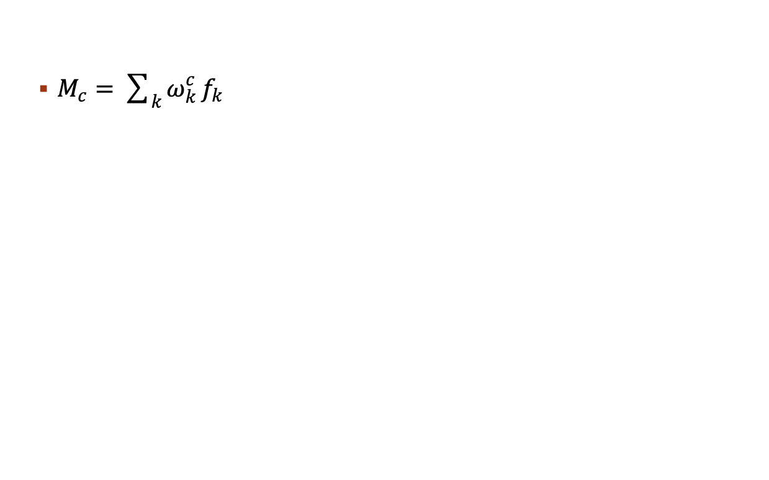
Class Activation Map (Cam)
$M_{c}=\sum_{k}^{ }{ω_{k}^{c}}f_{k}$
Notes:
The Class activation heatmap is obtained by multiple the features extracted with the weight of the classifier

Slide 33
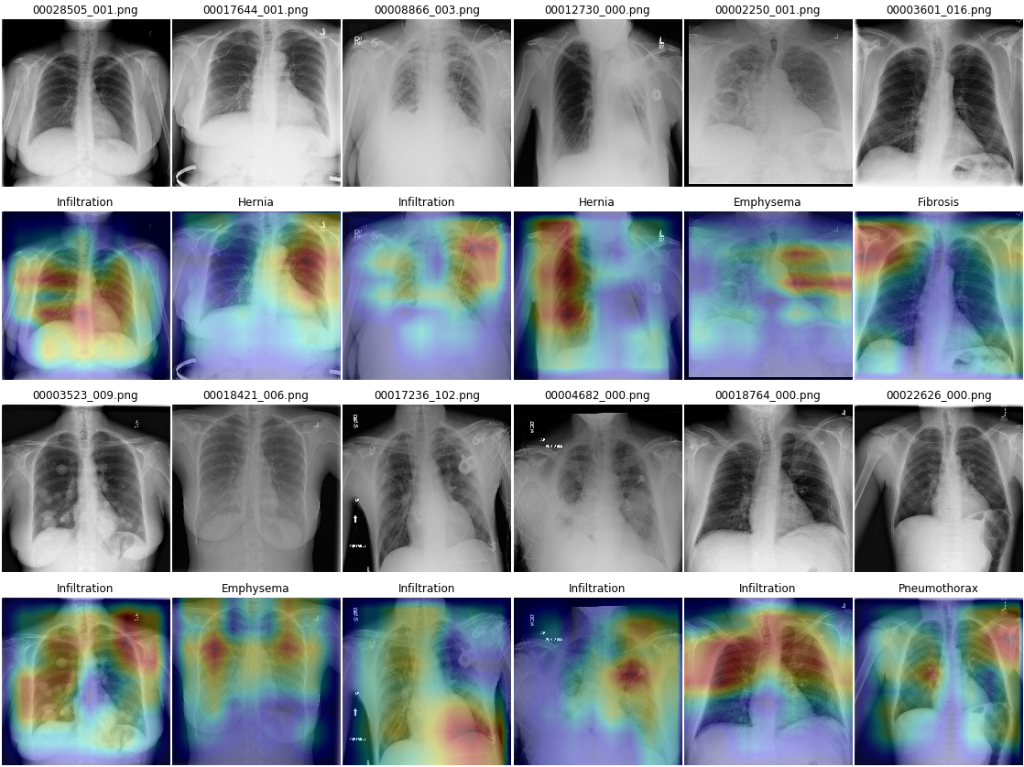
Result in Cam
CAM for top-1 disease. 1 means highest activated
Notes:
Result in CAM

Slide 34
Conclusion
Developed Segmentation Guided Thoracic Classification
Achieve average AUC of 0.843
Limitation:
Segmentation wrong -> cascade error
Not take clinical information into account: age, sex, gender, etc.
One CXR at a time, multiple CXRs may improve performance
Future Works:
Explore fusion between image data and clinical data
Explore multiple images setting
Notes:
So in conclusion, I have successfully developed

Slide 35
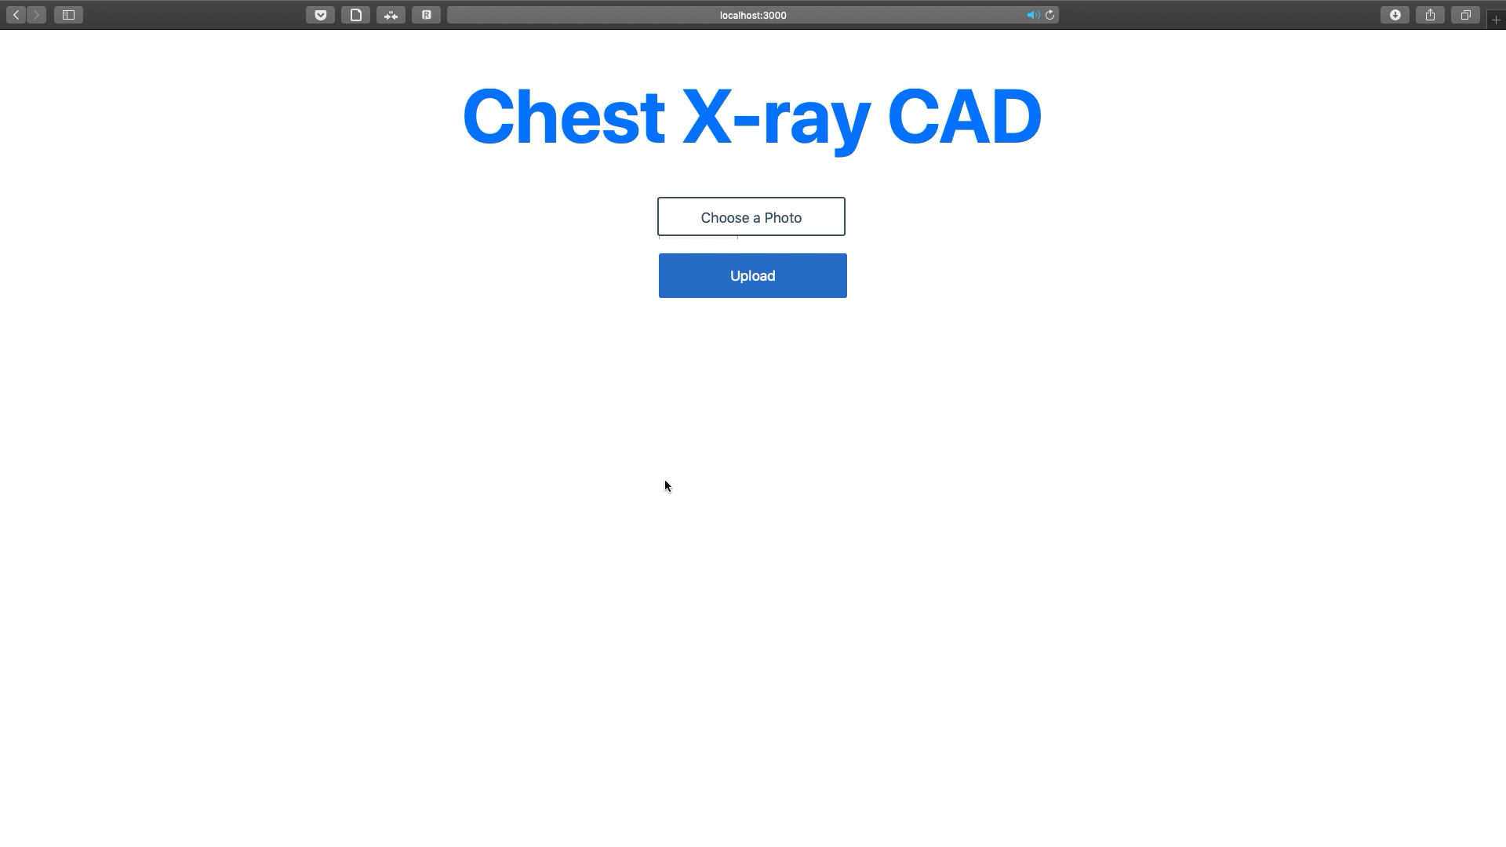
Demo
Radiologist-Level CAD to detect 14 Thoracic diseases
Trần Quang Đạt
Notes:
Add description for demo
….

Slide 36
Answer questions
Radiologist-Level CAD to detect 14 Thoracic diseases
Trần Quang Đạt
Notes:
This is the end of my defend
Thanks for your time
If you have any Q, I am very pleased to A

Slide 37
The End
Trần Quang Đạt

